Slide 1

Wishlister
CSCI 3300 – Team 6
By: Xavier Wood, Lane Meadows, and Brianna Bumpus

Slide 2
Team Members and Responsibilities
Xavier Wood – Team Leader, Database, Developer, General Features, Documentation
Lane Meadows – Facilitator, Developer, General Features, Documentation
Brianna Bumpus – Scribe, Project Documentation, Developer

Slide 3
Project Description
As a team create a web or desktop application that is a direct competitor to the website www.myregistery.com and is finetuned to the client’s specifications. To be competitive the application designed should allow for the creation, modification, deletion, and sharing of Registries/Wishlists.

Slide 4
Steps Taken for Project Completion
Create a Project Proposal to present to the client for approval
Create user stories addressing the client’s approved desired features
Create a schedule to track tasks and deliverables, to ensure project completion on time
Create the source code for the desktop application
Demonstrate the application to the client to confirm it is what was desired
Create test cases to test application functionality and make application adjustments as needed
Complete documentation for the project

Slide 5
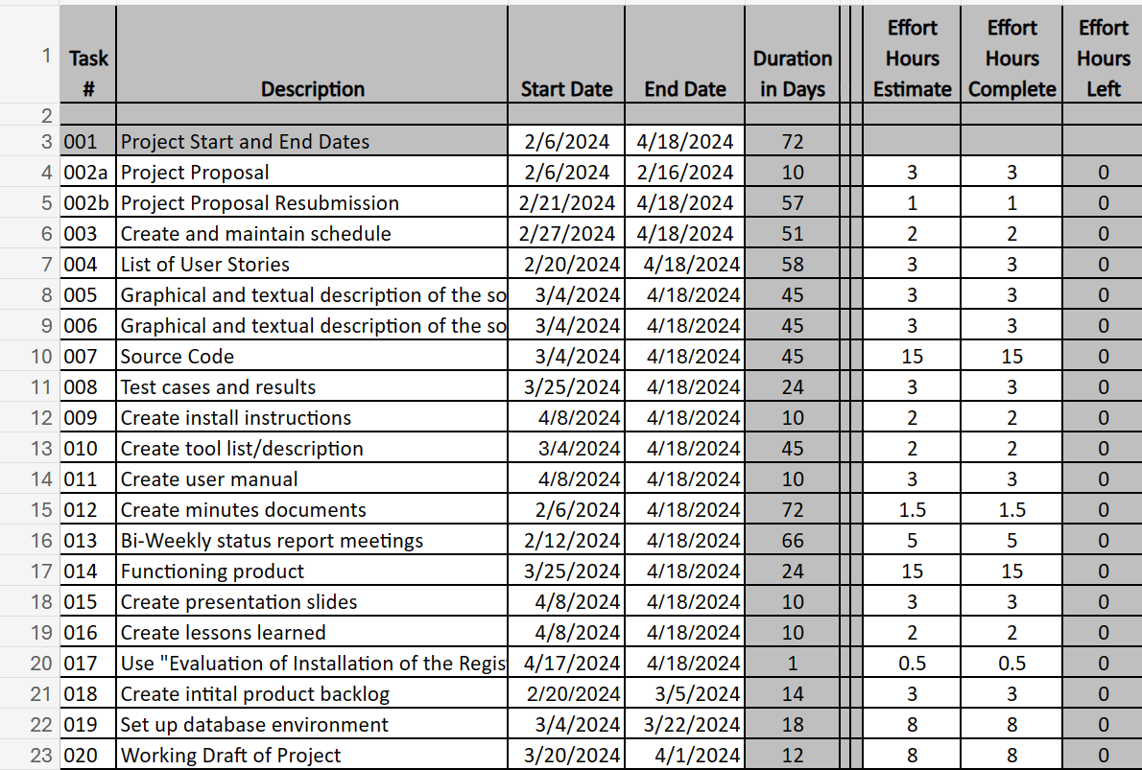
Project Schedule

Slide 6
Deliverables
Schedule
User Stories
Software Architecture
Software Design
Source Code
Test Cases
Installation Instructions
Tools Used
User Manual
Meeting Minutes
Presentation
Lessons Learned
Project Proposal

Slide 7
Tools Used
GitHub
URL: https://github.com/
Description: This platform was used to upload and share project source files, and enabled us to work remotely and collaboratively on the project.
Jira
URL: https://www.atlassian.com/software/jira
Description: Used for organization purposes such as, creating user stories and tasks that could be divided into manageable sprints.
Microsoft Word, PowerPoint, Excel
URL: https://www.office.com/launch/word
https://www.office.com/launch/Excel/
https://www.office.com/launch/PowerPoint/
Description: Microsoft Word, PowerPoint, and Excel are tools for creating and editing documents, powerpoints, and spreadsheets. UNG provides free access for students to these Microsoft tools, so it was easy to use these tools for most of our documentation needs.
Microsoft SharePoint
URL: https://ungprod-my.sharepoint.com/
Description: SharePoint is a tool we have access to via our UNG student accounts. Given that we were using the Microsoft suite to create and edit documents/files, SharePoint allows easy sharing, management, and simultaneous editing of Microsoft documents.
Discord
URL: https://discord.com/
Description: This platform facilitates communication with one another, so that we are able work on the project collaboratively in between our weekly stand-up/scrum meetings.

Slide 8
Tools Used (cont)
Lucidchart
URL: https://www.lucidchart.com/
Description: Used to create the Block Diagram in the Project Proposal.
Draw.io
URL: https://draw.io/
Description: Used to create the Use Case diagram and the Architecture Design model.
Visual Studio Code
URL: https://code.visualstudio.com/
Description: IDE used to develop code for the product.
MySQL
URL: https://www.mysql.com/
Description: DBMS used to store tables and data necessary for product functionality.
Microsoft Azure
URL: https://azure.microsoft.com/
Description: Cloud platform we used to host our database in the cloud, allowing for simultaneous, up-to-date access to the database
NodeJs
URL: https://nodejs.org/en
Description: Software that allowed for a local server hosting of our website.

Slide 9
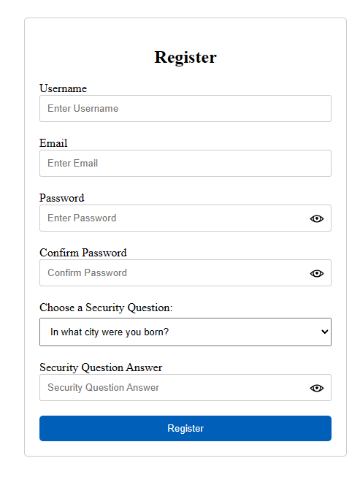
Feature 1
Users can register for an account to get full access to Wishlister features.

Slide 10
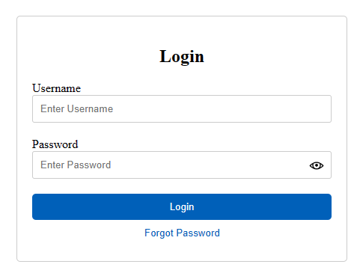
Feature 2
When users return to the Wishlister application they can login to access their account. Additionally, if a user forgets their password they can reset it from this page.

Slide 11
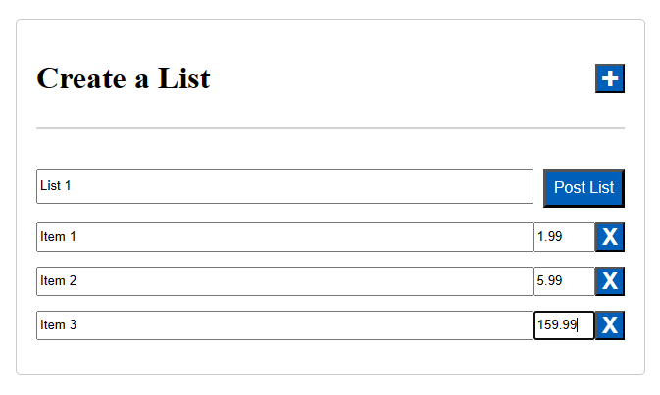
Feature 3
Once a user is logged in, they can create a wishlist, and then they can add items and prices to the list.

Slide 12
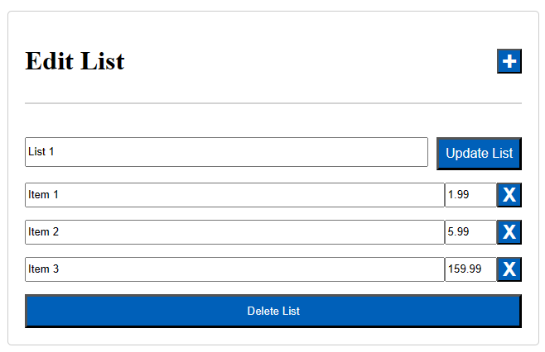
Feature 4
From the edit list page a user can edit a Wishlist, but they can also delete it if they no longer have a use for it.

Slide 13
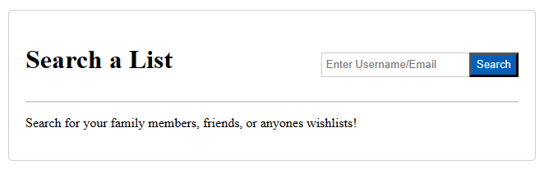
Feature 5
Wishlists can be shared amongst family and friends by searching with the Wishlist creator’s username or email.

Slide 14
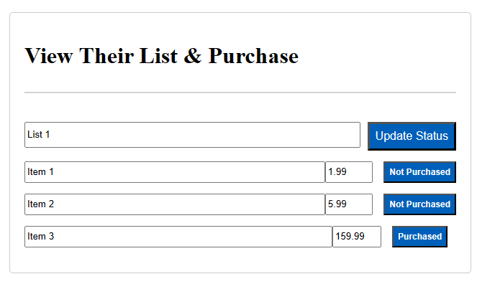
Feature 6
Once a user finds the desired wishlist they can view the items and mark them as “Purchased”, to ensure an item isn’t bought more than once.

Slide 15
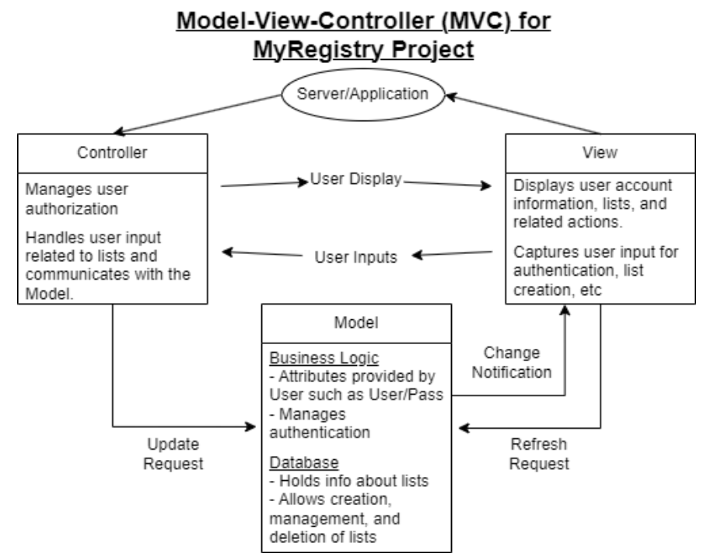
Project Architecture
The architecture that our software uses, as with many other database-based websites, is the Model View Controller architecture. In this architecture, depicted below, the model, view, and controller aspects all interact to handle user inputs, user interface, and database management.
The model aspect is made up of the server and the database. This is the backend of the website where update requests are received from the controller which then either queries the database or runs a function defined in the server.
The view aspect is the user interface with which the user interacts. This is the html of the site where the inputs that a user interacts with are sent to the controller which handles the communication with the model. When a user makes a change, a refresh request is also sent directly to the model which will send a change notification upon receiving the update request from the controller.
The controller manages all user inputs and updates the display accordingly.

Slide 16
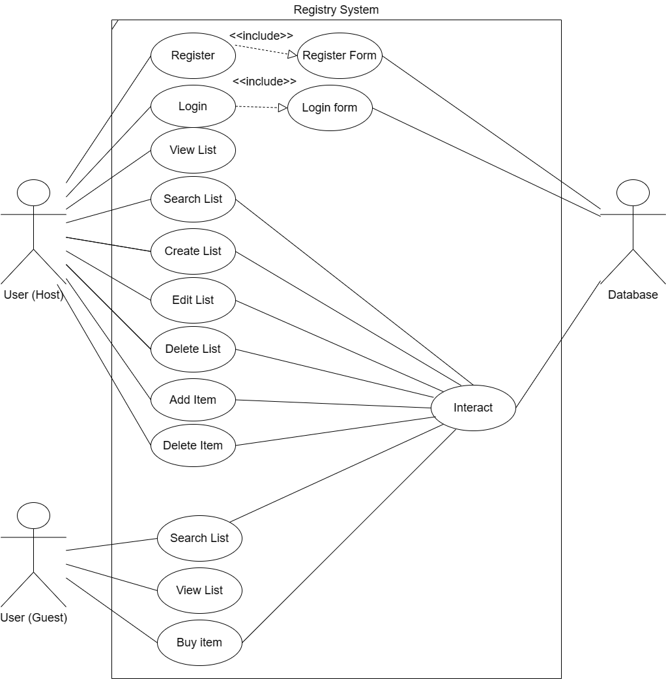
Project Design
The design that our system uses connects two different types of users (Host and Guest) to the database in a certain way. The User (Host) can Search a List and View a List. To access all the features of the website the User (Host) must register and login. After that they can, Create a List, Edit their List, Delete their List, Add an item to their list, and Delete an Item to their list. The User (Guest) can also Search a List and View a List. Another thing that they can do is mark an item as purchased or not purchased. The reason we have an Interact bubble that connects from the use cases to the database is because those use cases push and pull data from the database.

Slide 17
Scenario for Wishlister User
Sandra is pregnant with her second child and planning a baby shower. She has kept a lot of the toys, clothes, and baby supplies from her first child. Sandra wants a way to tell her friends and family what gifts and supplies she’d appreciate. She doesn’t want to accidentally receive any items she already has, and she doesn’t want to receive duplicates of gifts.
With Wishlister, Sandra can register for a free account and create a Wishlist for her baby shower. After she creates the list, she can add any items she desires as text or as a link. Sandra can then share her username with her friends and family and they can search on Wishlister with it to find her Wishlist. Once they find her Wishlist they can view everything she wants, and if they buy an item, they can mark it as bought so it doesn’t get bought a second time. If Sandra changes her mind about an item, she can also go back into her account and remove the item from her Wishlist.

Slide 18
Stories for Wishlister
As a new user (not registered)
MRP-1: As a new user, I would like to create an account, so that I can save my lists.
MRP-2: As a new user, I would like to personalize my account with a unique user/pass, so that I can login.
MRP-36: As a new user, I would want to find a registration option easily accessible from the homepage.
MRP-37: As a new user, I would like a clear and intuitive registration form with fields for entering a username, email address, and password.
MRP-38: As a new user, I would like to see a prominent "Register" or "Sign Up" button on the homepage for quick access to the registration page.
MRP-40: As a user, I would like the login page to have a link to the registration page for new users to sign up.
As a user (registered)
MRP-4: As a user with an account, I would like to be able to update my password, so that I can login if I forget it.
MRP-27: As a user, I want to be able to create a list, so that I can save items I want.
MRP-28: As a user, I want to be able to share a list with friends, so they can purchase items for me.
MRP-29: As a user, I want to add items from my favorite sites, so that I save them as a list.
MRP-33: As a user, I want to be able to delete a list, so that once an event is over I can free up space.
MRP-39: As a registered user, I would like a clean and intuitive login form with fields for entering my username/email and password.
MRP-3: As a user concerned with security, I would like to create a password, so that I can protect my info.
MRP-6: As a user concerned with security, I would like to be able to update my password, so that I can protect my info.
MRP-41: As a user, I would like to be able to add items after I create the list, so I can add more items.
MRP-42: As a user, I would like to delete items off my list after creating the list, so nobody will buy an item I don't want.

Slide 19
Stories for Wishlister (Cont.)
As a user (Viewing the list)
MRP-7: As someone viewing a user’s lists, I would like to view them without logging in, so that I can purchase the gifts anonymously.
MRP-19: As a friend of a user, I would like to mark a gift as purchased, so that only one is gifted.
MRP-34: As an external user, I would like the UI to be user friendly, so that I can easily access a list.
As a developer
MRP-13: As a developer, I want to create a database that can store links, so a list of items can be created.
MRP-16: As a developer, I want to link a database to account, so that users can store their lists.
MRP-17: As a developer, I want to create a user friendly UI, so that users can easily create, access, and manage their lists.
MRP-18: As a developer, I want to save a user's login, so they can access their save lists later.
MRP-31: As a developer, I want to link a database to an html website, so that I can access the database through the UI.
MRP-32: As a developer, I want to update a database from a html website, so the User can create and manage lists.

Slide 20
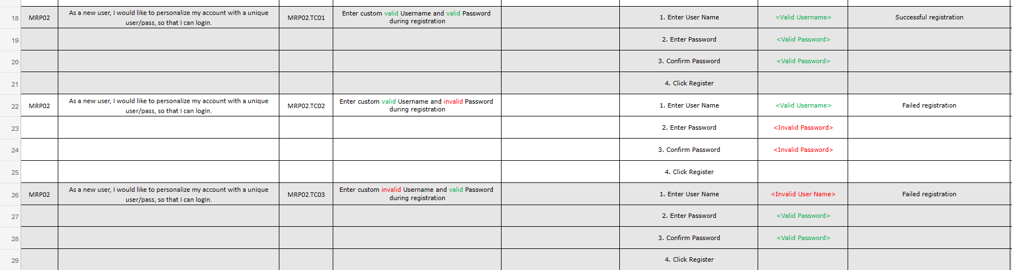
Test Cases
Test cases for MRP02: As a new user, I would like to personalize my account with a unique user/pass, so that I can login.

Slide 21
Lessons Learned
What went well
Using Discord for easy communication between team members
Creating a schedule to keep track of tasks and task due dates. As well as tracking progress made towards tasks to ensure we were on track to finish on time.
Using GitHub to create a repository that could be shared, so that code could be knowledgeably developed based on the most current version of files.
Microsoft Sharepoint was very useful for cloud-based, synchronous, document editing and sharing. We found Sharepoint worked better than GitHub for Word, Excel, and PowerPoint file sharing as GitHub doesn’t support viewing these documents from the browser.
Asking for clarification with the professor/client on requirements when needed
Being prepared for unexpected circumstances (our ex-team leader dropping the class)
Dividing the work and making sure everybody knew what they were working on, to efficiently complete the work.
Improvements
Having to adjust to new technologies that some or all team members were unfamiliar with such as, GitHub and Jira
Asking for clarification of project requirements earlier so we had a more accurate deliverables list from the start
When we tested the system, we should have included more negative testing. We primarily focused our efforts on positive testing to ensure everything worked as desired, but due to time constraints our negative tests weren’t as comprehensive as the positive tests.

Slide 22
Questions?

